Slide 2
Learning outcomes for today
Develop your understanding of the Student Rep role and describe the work involved in being a Student Rep
Discuss the student learning experience and explore how you can use it to assist you in your work as a Student Rep
Develop some of the skills you will use as Student Rep

Slide 3
Exercise 1 – Group introductions
Speaking for about a minute, let your fellow reps know:
Who you are
What course you are doing
Why you wanted to be a rep, how you came to be a rep

Slide 4
Exercise 2 – Your rep role
Talk to your fellow reps:
What do you think the purpose of the student rep is?
What do you think some of the tasks will be?
What skills do you think you will need and develop as a rep?
How do you think being a rep will benefit you?

Slide 5
Student Reps
The Student Rep role...
Purpose of a rep
To continuously improve the student learning experience in partnership with the College and the Students’ Union by helping create solutions to problems
To represent your fellow classmates’ views and opinions on all matters relating to learning and teaching
To provide both positive and negative feedback to staff
To act as a communication channel between staff and students

Slide 6
Student Reps - Tasks
Introduce yourself to your class
Gather student opinion
Provide feedback to staff and students
Present student views at meetings
Attend meetings when required
Develop solutions to issues
Pass issues on to the Students’ Union
Attend focus groups if required
Attend rep conferences and SU AGM

Slide 7
Student Reps - Skills
Communication
Listening
Networking
Relationship building
Reflection
Presentation
Organisation
Report Writing
Diplomacy
Negotiation
Research
Time management/prioritisation

Slide 8
Benefit of being a Student Rep
Learn new skills
Looks good on your CV
Networking opportunities
Background for future representative roles
Good experience for future employment
Make a difference

Slide 9
Exercise 3 – Your course of study…
In your small groups, discuss the following questions:
What would you like to change or improve about your course or College in general?
Write this down on a post-it note for use in a minute!

Slide 10
Why is representation important?
Student
views
Dialogue
with staff
Improved learning or college
experience
You are an expert on your learning experience

Slide 11
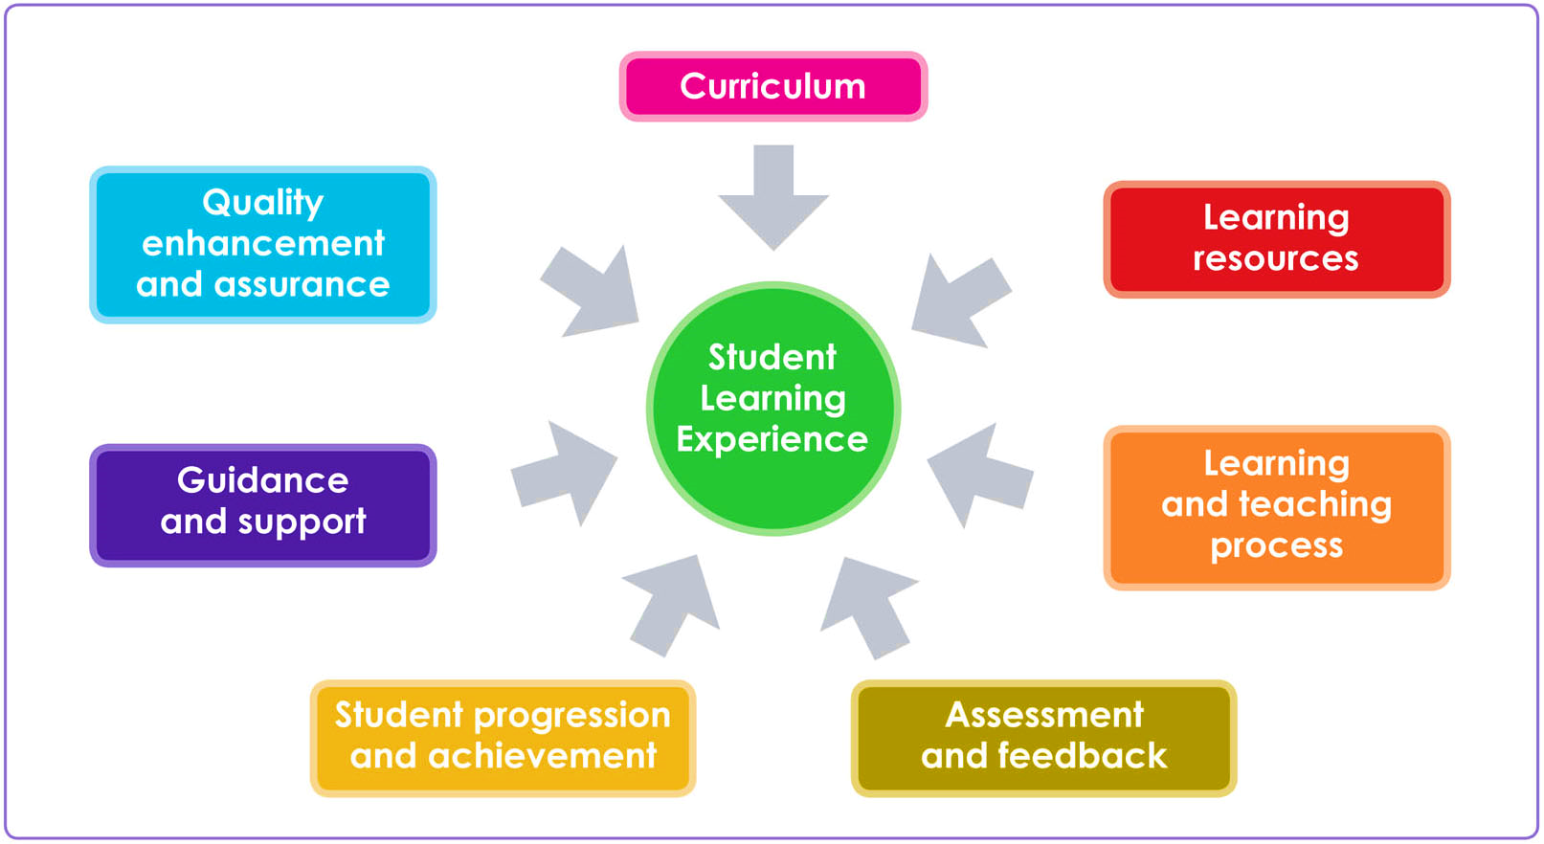
The Student Learning Experience

Slide 12
The Student Experience

Slide 13
The Student Experience

Slide 14
The Student Rep Cycle
Feedback
(to students)
Identify the issue
(by gathering student opinion)
Develop &
implement
the solution (or at least try to)

Slide 15
What to do with student views or problems

Slide 16
Complaints & Policies and Procedures
1
2
3

Slide 17
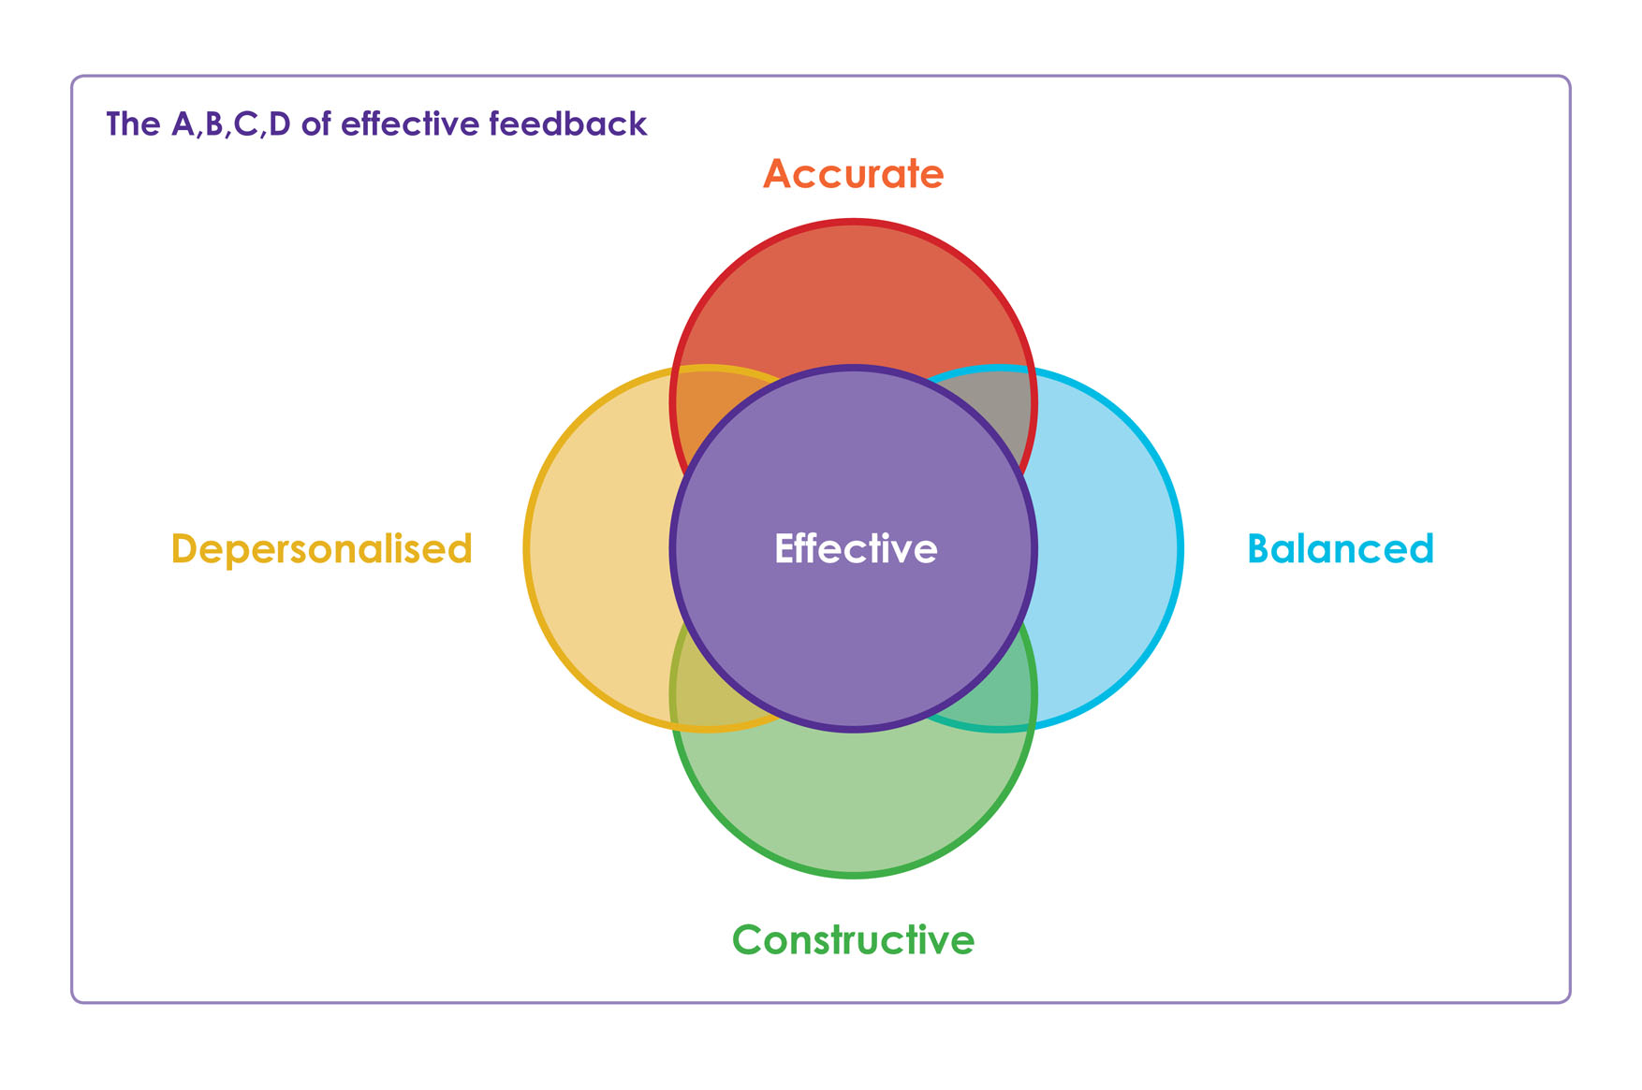
The A,B,C,D of Effective Feedback

Slide 18
A is for Accuracy
I have spoken to some of my class and we think that there is not enough practical work on the x module.
I have had a discussion with my class and we agreed by a show of hands 18/21 that there is not enough practical work on the x module.

Slide 19
B is for Balanced
The whole course is really not well put together and the assessments don’t fit well with the teaching.
While most elements of the course are taught well, are interesting and understandable it would be helpful to have more practical work to back up the theory. Practical assessments would also help us feel confident that we can perform the tasks well.

Slide 20
C is for Constructive
As a class we never know what we are supposed to be doing from week to week in our x module classes.
The class are keen to have a plan of work and assessments given to us at the beginning of each semester in our x module classes.

Slide 21
D is for Depersonalised
After discussion with the class we want to tell you that Mr Smith is a terrible tutor who never gives assessments back on time.
After discussion with the class we want to say that the return of assessments in our x module classes is always too late to enable us to learn from our mistakes for the next assessment.

Slide 23
Safeguarding
What is it and what part do you play?
Can I promise confidentiality?
Where can I get help?
Speak to your tutor or call 252 3733

Slide 24
Rep Conferences
Big events attended by all Reps giving everybody an opportunity to have a say and discuss life at College. These will be organised by the Students’ Union and attended by College managers too.
19th October 2018, 18th January 2019, 3rd April 2019

Slide 25
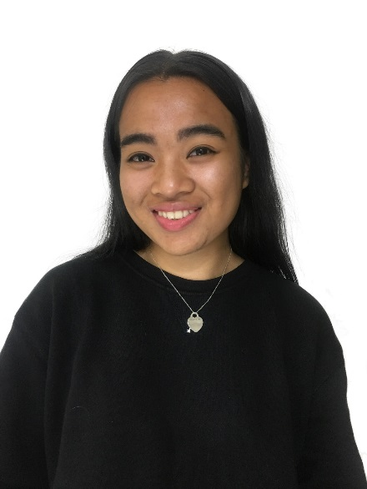
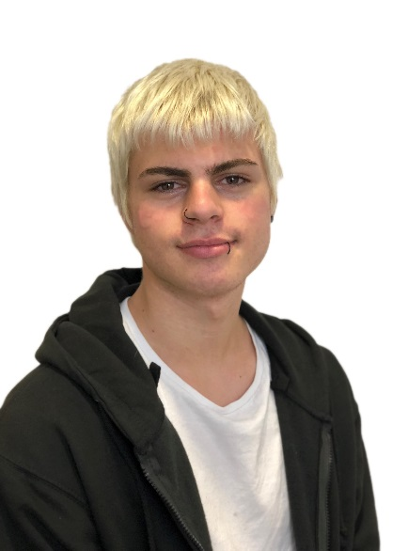
Students’ Union
“Welcome to your role as Student Rep. You will be fulfilling a key role in representing the views of your fellow students, being best placed to let the College know what is going well and what not so well. Having student voices heard is essential to make sure that students get the best out of their college experience.
We will be here to support you every step of the way if you need it, so please don’t hesitate to get in touch with us.”
Julliana Mohamad Noor
Skye Turner
SU President
SU Vice President
juliana.m.noor@liv-coll.ac.uk
Skye.Turner@liv-coll.ac.uk
Every student is automatically a member of CoLCSU when they join the College. Together we are a union of students where individuals connect, have fun, build communities, share experience and make change.

Slide 26
Student Parliament
This a meeting of all School Reps and the executive officers who will help to make decisions about things that affect students across the college and how the Union should spend their budget.

Slide 27
Could you be one of the
SU Executive Officers…?
BAME Officer (Black, Asian/Minority Ethnicity)
Disabled Students’ Officer
Fundraising Officer
H.E. Officer (Higher Education)
LGBTQ+ Officer (Lesbian, Gay, Bisexual, Trans, Questioning, Other)
Student Voice Officer
Women’s Officer
5 x Vice President for: the Arts Centre, Clarence Street, Duke Street,
the Learning Exchange, Vauxhall Road, and more…
These roles are open to all students aged 16 or over
For more information contact the Students’ Union: Room 2/46 in the Learning Exchange or email: students.union@liv-coll.ac.uk

Slide 28
Have you got any questions?
You can ask the Student Engagement Team (Enrichment) in any of the following ways...
Come and see us in room 2/47 @ The Learning Exchange
Email: SET@liv-coll.ac.uk
Call 0151 252 4880

